Slide 1
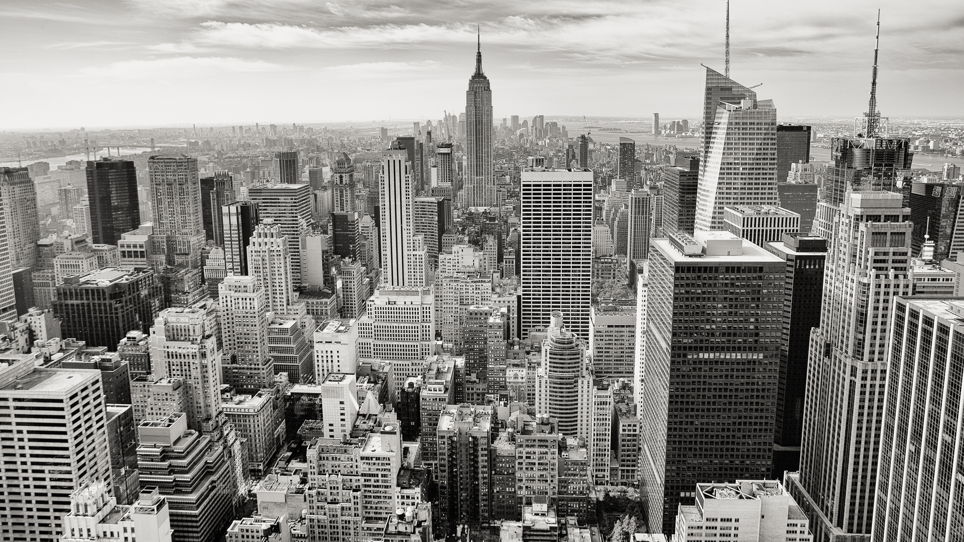
WeavelBot
A weather traveling bot
The easiest way to have a trip.

Slide 2
Why Travel?
Everyone needs travel.
According to Oxford Economics, Travel & Tourism’s contribution to world GDP
outpaced the global economy for the sixth consecutive year in 2016,
rising to a total of 10.2% of world GDP (US$7.6 trillion).
Hi!
你好～
もしもし
안녕하세요
สวัสดีครับ
Hello, I'm WeavelBOT!Where do you want to go?
你好, 我是 WeavelBOT!
你想去哪遊玩呢?

Slide 3


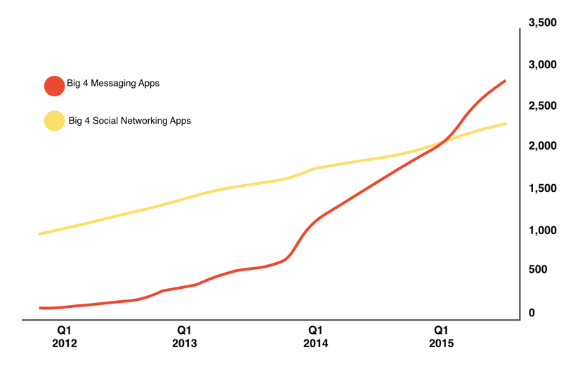
Why Bots?
Have you ever heard bots will replace websites and apps?
“Only 1,000 of the one million apps in the iOS App Store or Android’s Google Play Store have 50,000 or more users. That’s only one-tenth of 1% of all apps. And Although many people have lots of apps on their smartphones, Quantcast reports that as many as 50% of people who download an app only use it once!” Jillian D’Onfro | Business Insider.
Bots will be faster than websites and mobile apps
Bots will be easier to use than any other technology ever created.
Every business is going to have a bot.
Notes:
Delete pictures
Drag and Drop your images

Slide 4
Data Collection
UV
Temperature
Comfort index
short time
Probability of Precipitation
PM2.5
Weather Condition
Weather
7-days
Data
Collection
latitude and longitude
Address
Spot
1.Taiwan www.data.gov.tw
2.Japan www.data.jma.go.jp/developer/index.html 3.Thailand
https://openweathermap.org/api
4.Korea
https://openweathermap.org/api
Comment
Score

Slide 5
Process
NLP
User
Input
Output
Server
request/
update according to user feedback
label and score
by comment
Data
Collection
database

Slide 6
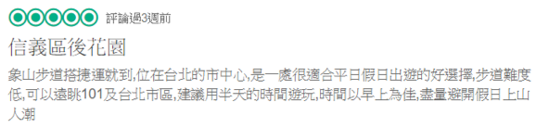

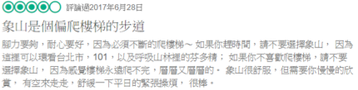
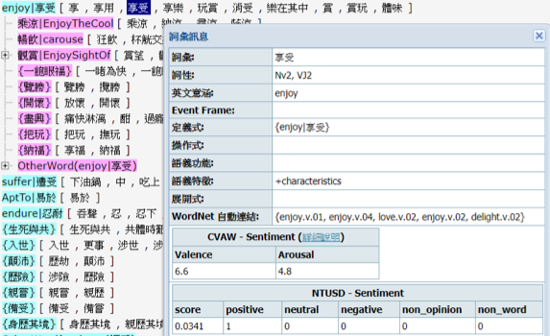
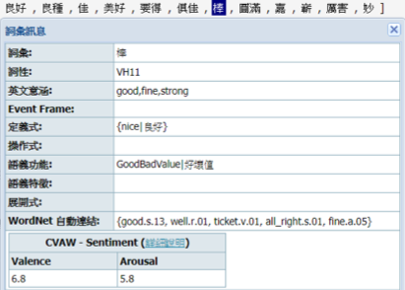
Scoring and Label System

Slide 7

Seven Important Factors to take into account
Map
Time and Distance
Weather
Estimate Cost
Scoring System
Items you need
Multiple Language

Slide 8


WeavelBot
—
NTUEE,
No.1, Sec. 4, Roosevelt Road, Taipei, Taiwan 10
Notes:
Delete Picture
Drag and Drop your image
Send to Back

Slide 9
Thanks for Listening
Wish you have a nice trip!

